Slide 1
Project title
Team members name with enrolment number
Guided by

Slide 2
Project title
Listout the entire modules

Slide 3
Objective of the Project

Slide 4
Title of the project
Goal of your module(s)
List out your module and mention submodule also

Slide 5
Module 1
Definition
Sub module details
module interconnection details also
…….

Slide 6
Module 2
Definition
Sub module details
module interconnection details also
…….

Slide 7
Module 3
Definition
Sub module details
module interconnection details also
…….

Slide 8
Project overview
Highlight your module in this project architecture diagram
The overview like => example
Project Architecture
Approved
Customer
Pending
Login
Dashboard
Stock maintenance
Report
Order
checkout

Slide 9
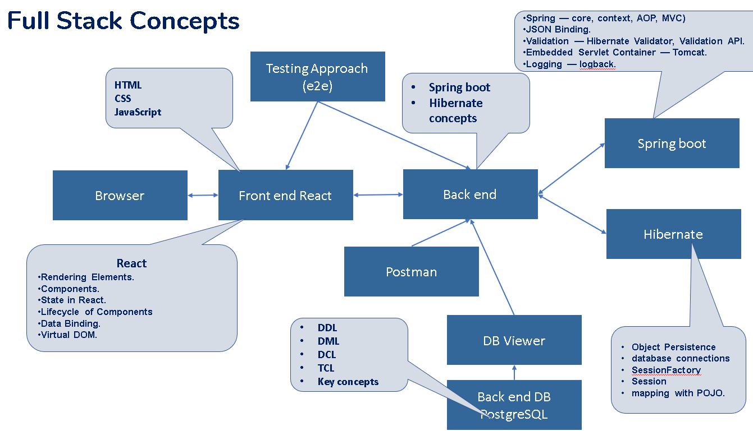
Tech architecture
You want to mention the your technical approach and add the diagrammatic presentation example this

Slide 10
Dataflow diagram
Sequence diagram or package diagram or activity diagram or Dataflow diagram or etc.,
Choose anyone diagram

Slide 11
Challenging issues
Have you faced any challenging issue during project implementation time try to mention it (problem with solution)
Mean while if you have innovative ideas in your project explain it

Slide 12
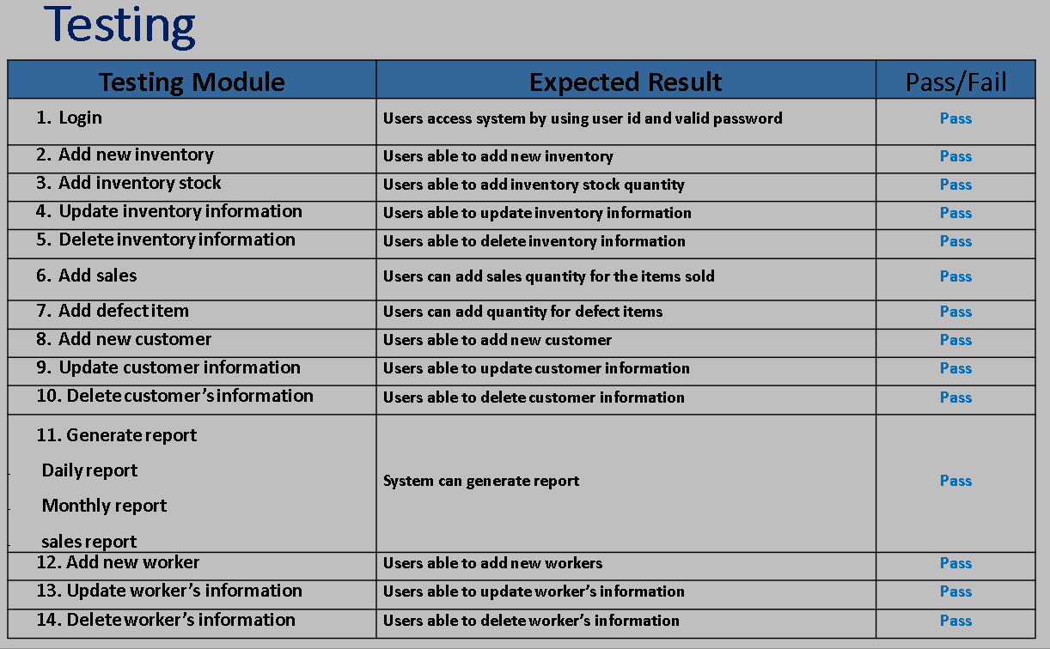
Testing
Tested result
Testing tools approach information
Zero defect certification information
Refer the example

Slide 13
Features about the module

Slide 14
Future enhancement

Slide 15
Conclusion

